Slide 1
Group 3 San Marcos
Jacob Hopkins, Andrew Kelly, Anne Leach, Daniel Lopez

Slide 2
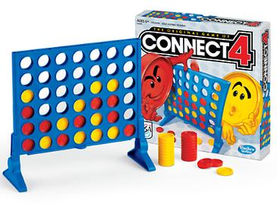
Project Overview
Connect 4 Game
Our goal was to simulate the classic Connect 4 game following the Model-View-Controller design pattern.
Language: Java 12
Additional Libraries: JavaFX, J-Unit
Tools: Apache Maven
This Photo by Unknown Author is licensed under CC BY-SA

Slide 3
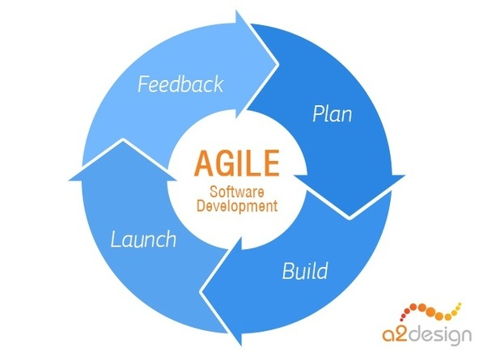
Project Goals
Development Process
Use of Git and avoiding merging conflicts with group.
Agile Software Development method
Plan, Development, Early release, Feedback, and continual improvement.
Automated Testing using Junit

Slide 4
Project Summary
A.I. Algorithm
For single player games an AI script was made which determines optimal placement by means of a series of comparisons.
Evaluates each column individually, storing each score in an array. A.I. then returns the highest scoring column.
The scoring algorithm will first check for a win condition. A placement resulting in its own victory will yield the highest score, while a player win condition is given the second highest.
Next the algorithm will check if the column is adjacent to two or fewer pieces of the same color. This is given the next highest scores, as such placement will be either offensive or defensive depending on the piece color.
Lastly, if placing a piece would set up the player for a win, it is given the lowest score, unless such a placement would result in the AI winning. The highest scoring column is returned.

Slide 5
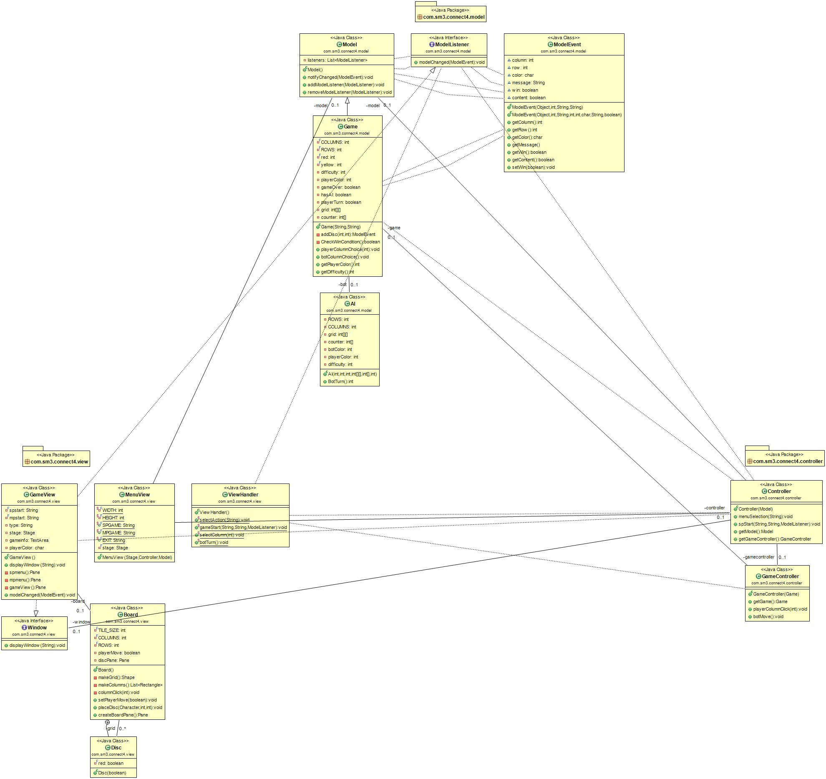
Project Summary
Uml Class Diagram
Model
View
Controller
The UML Diagram is automatically generated based on our source code.

Slide 6
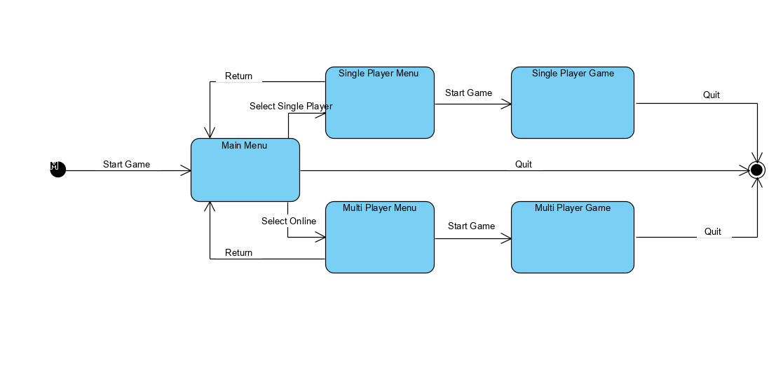
Project Summary
Statechart Diagram

Slide 7
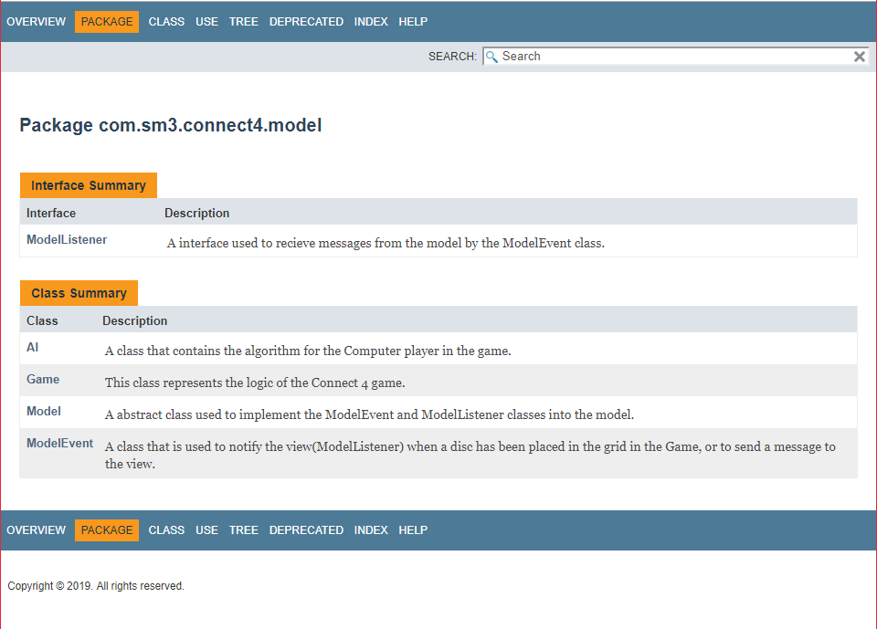
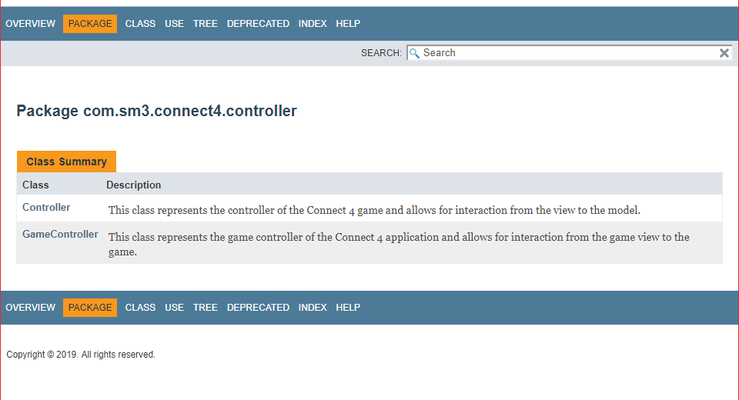
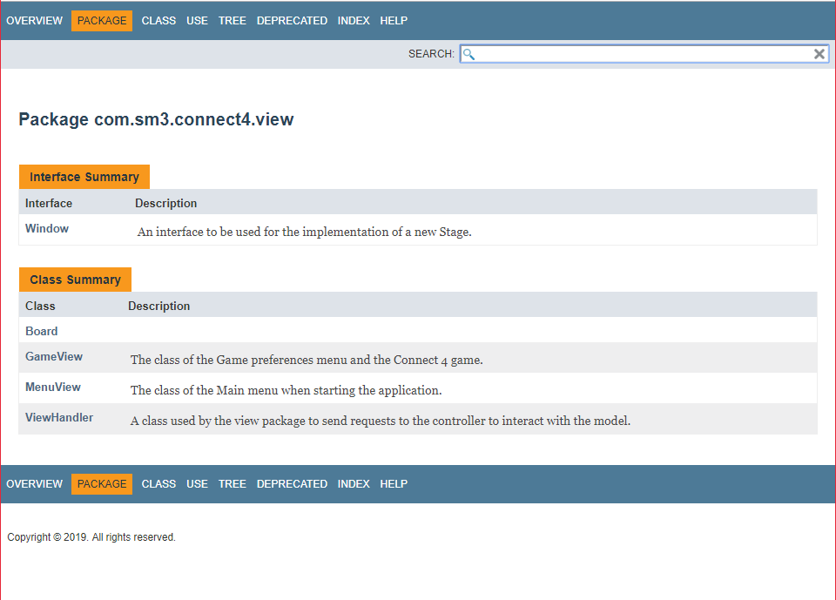
Project Summary
Javadoc
Javadoc found in our github - https://github.com/group-sm3/connect4-sm3/tree/master/docs/javadoc

Slide 8
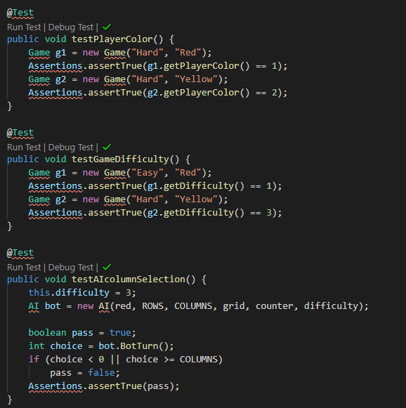
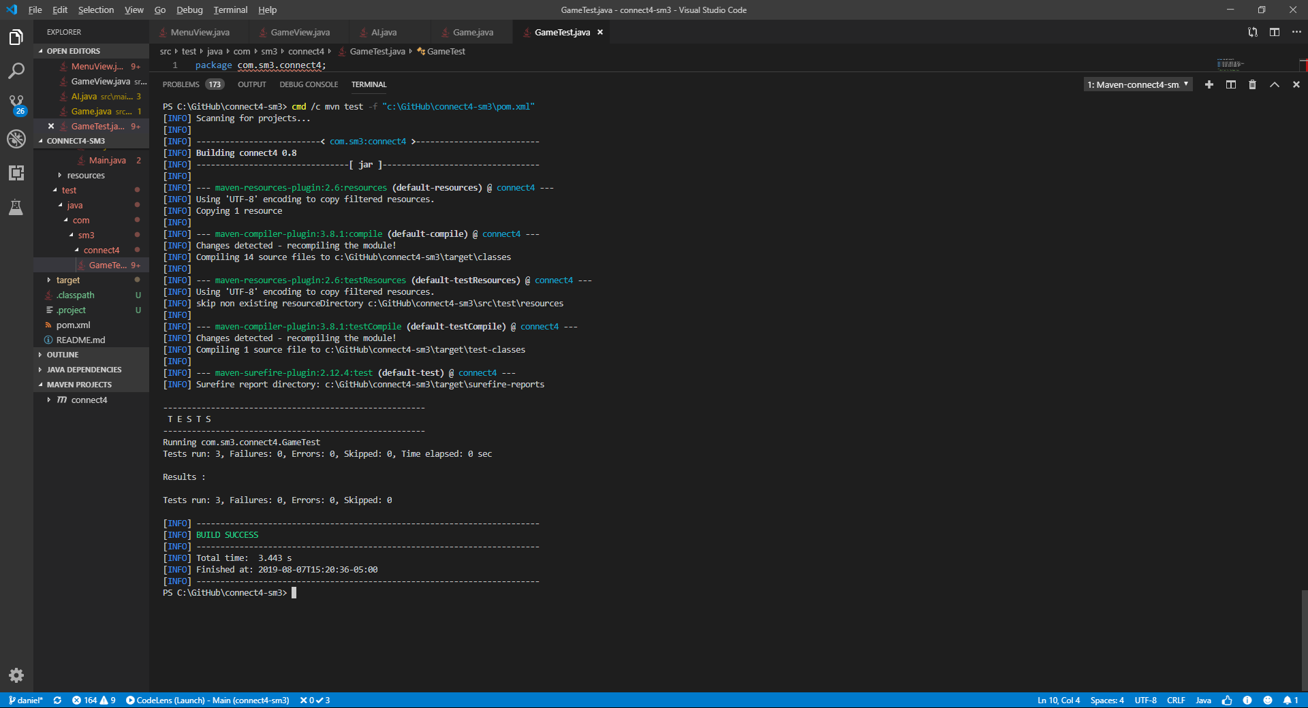
Project Summary
Junit 5 Tests
The testcases are automatically executed using Apache Maven.

Slide 9
Project Summary
Future development and improvements
Continue to work on merging the server/client files with the game model to allow for online multiplayer.
Update graphics.
Add audio.
Add more user preferences.

